Slide 1
ATAI
Advanced Technique of Artificial Intelligence
Chongqing University ^{ATAI}
_{of Technology} Advanced Technique of
Artificial Intelligence
Chongqing University of Technology
Zoom Out and Observe:
News Environment Perception for Fake News Detection
code:https://github.com/ICTMCG/News-Environment-Perception
CIKM 2022
Reported by Minqin Li

Slide 2
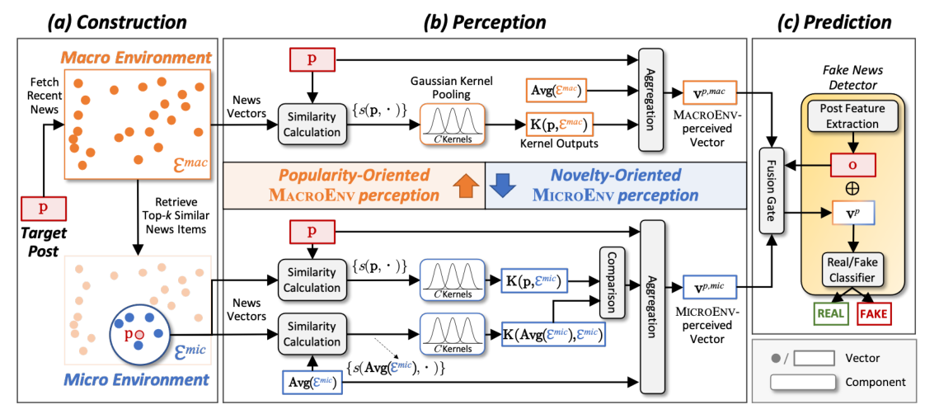
ATAI
Advanced Technique of Artificial Intelligence
Chongqing University ^{ATAI}
_{of Technology} Advanced Technique of
Artificial Intelligence
Chongqing University of Technology
Method

Slide 3
ATAI
Advanced Technique of Artificial Intelligence
Chongqing University ^{ATAI}
_{of Technology} Advanced Technique of
Artificial Intelligence
Chongqing University of Technology
Method
'''Gaussian Kernel Pooling
input:The similarity list.
output:c-dimensional vector.(c is the number of Gaussian kernels)
'''

Slide 4
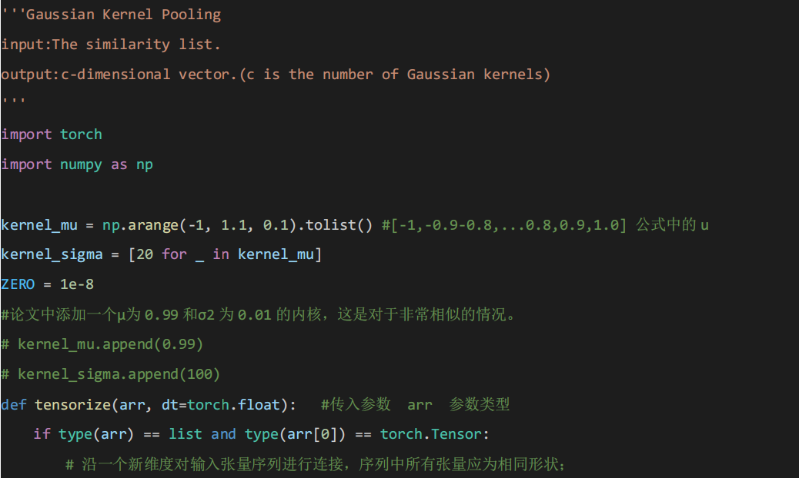
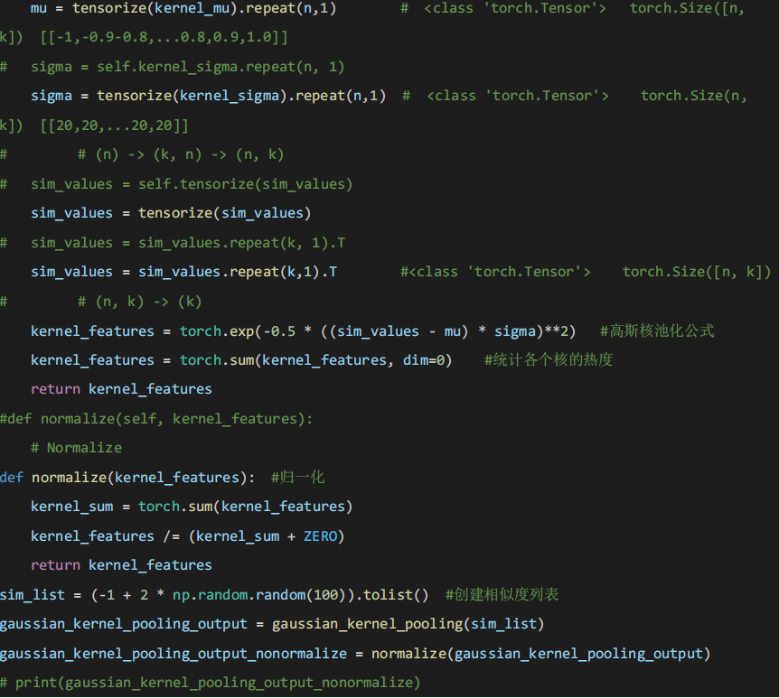
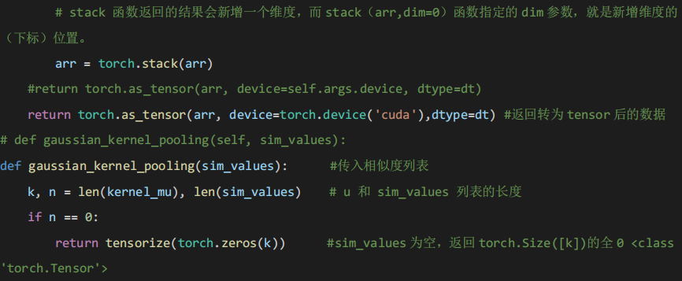
ATAI
Advanced Technique of Artificial Intelligence
Chongqing University ^{ATAI}
_{of Technology} Advanced Technique of
Artificial Intelligence
Chongqing University of Technology
Method

